Slide 1
Class Diagram and State Diagram
Session 19
(Lecture)
Course : Program Design Methods
Effective Period : July 2018

Slide 2
These slides have been adapted from
- Simple Program Design : A Step by step approach., Lesley Anne Robertson, Fifth Edition, Course Technology. ISBN: 978-1-4239-0132-7. Chapter 12
- Britton, C.. (2005). A student Guide to Object Oriented Development. 01. Butterworth-Heinemann. Amsterdam. ISBN: 978-0-7506-6123-2. Chapter 4 - 5
Acknowledgement

Slide 3
LO 5 : Explain the object oriented design
Learning Objectives

Slide 4
Contents
Class Relationship
Association
Aggregation and Composition
Dependency
Generalization
Introduction to State Diagram
States and Events
Constructing a state diagram

Slide 5
Class Relationship
Major advantage of object-oriented programming language is their usefulness in constructing large programs
In designing programs that use multiple classes, need to consider the relationship between the classes and therefore between the objects that are instantiated from those classes

Slide 6
Class Relationship
Three types of relationship between classes:
    Relationship between two classes that are independent of each other but one class might use the services the other provides – Association
    Class may be made up of other classes or contain other classes that are part of itself – Aggregation or Composition
    Class may inherit all the attributes and operations of a parent class but is given a unique name - Generalisation

Slide 7
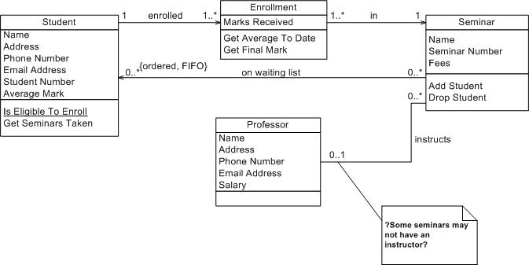
Association

Slide 8
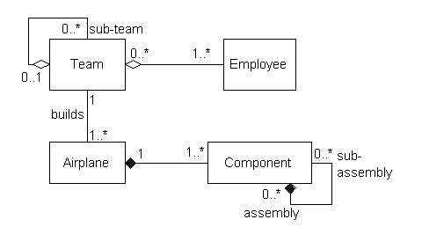
Aggregation and Composition

Slide 9

Dependency
Dependency
  A dependency describes a relationship between two classes where one (called client) uses the other (called supplier).
  In UML, draw a dashed line with an arrow from the client class to the supplier class.
  For example, The Calendar class uses Date because you can set a calendar with a specified Date object.
  The relationship between Calendar and Date can be described using dependency, as shown

Slide 10
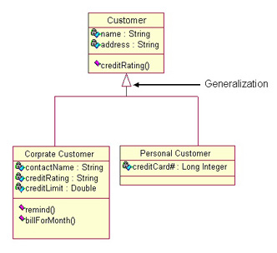
Generalization

Slide 11
Class Diagram
The class diagram is used to model classes and the relationship between classes, and also to model higher-level structures comprising collections of classes grouped into packages

Slide 12
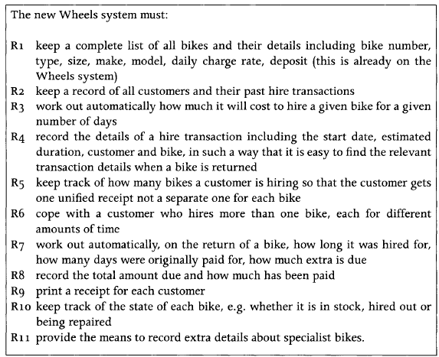
Cases: Wheel List Requirement

Slide 13
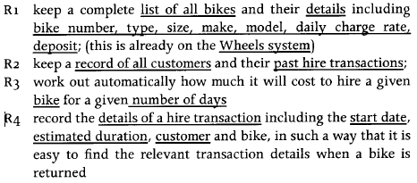
Identify Noun and Noun Phrase

Slide 14
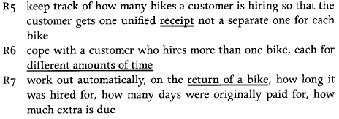
Identify Noun and Noun Phrase

Slide 15
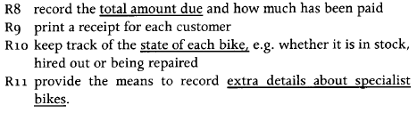
Identify Noun and Noun Phrase

Slide 16
Candidate Object from Noun and Noun Phrase
Candidate Object | Candidate Object
list of bikes details of bikes: bike number, type, size, make, model, daily charge rate, deposit Wheels system record of customers past hire transactions bike number of days details of a hire transaction: start date, | estimated duration customer Receipt different amounts of time return of a bike total amount due state of each bike extra details about specialist bikes.

Slide 17
Objects should be rejected if they are:
Attribute: Bike number, type, size, make, model, daily charge rate and deposit, Number of days, different amounts of time, total amount due, extra details about specialist bikes, start date, estimated duration, hire transaction
Redundant: past hire transaction and hire transaction, different amount of time and number of days and estimated duration
Too vague: return of a bike
Too tied up with physical inputs and outputs: Receipt qualifies for rejection under this heading. Receipt is an output; it is also redundant as we either store or can calculate the details we would print on it. List of bikes also requires some consideration. record of customers

Slide 18
Objects should be rejected if they are:
Associations: hires is modeled as an association between Customer and Bike ?
Outside the scope of the system: In this category would be anything we have decided to be beyond the system boundary
Really an operation or event: If a candidate object seems to have no data associated with it, then it might be better modeled as an operation on another class. For example: hiring a bike might be described as an event but as there is associated data, start date and number of days, we are more likely to want to model it as an object
Represent the whole system: It is not normally a good idea to have an object that represents the whole system; we want to divide the system into separate objects. Wheels system should be rejected for this reason.

Slide 19
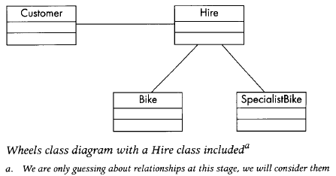
Wheel System Object Result
Bike
Customer
Hire Transaction
Specialist Bike

Slide 20
Write a data dictionary
Detailed information about classes and their attributes is recorded in the data dictionary, which acts as a central repository with agreed terms and their meaning expressed in a standardized notion

Slide 21
Data dictionary notation
Meaning | Symbol | Description | Example
Consist of | = | Introduces the definition of data item | Customer=
And | + | Joins components of the definition in sequence | Customer=name+address
One or more | { } | Attributes may be repeated; any restrictions on number of repetitions are shown by a subscript | Customer = name+address+{phone}₂
Zero or more | ( ) | Attribute is optional | Customer = name+address+{phone}₂+(email)
Alternatives | [ ] | Selection is indicated by enclosing the alternatives in square brackets[] | Name=[initial | firstname]+surname
Either..or | | | Alternatives for selection in[ ] are separated by a vertical bar
Specific value | “ “ | Indicates specific value | “individual”, “wholesale”
*..* | Comment | Comments are enclosed between asterisks | Customer = name+address+{phone}₂+(email)+ [“individual” | “wholesale”] *wholesale customers are entitled to special discounts*

Slide 22
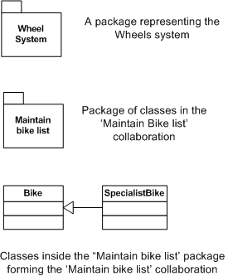
Packages
Packages provide a mechanism for managing models by grouping modeling elements.
The complete class diagram, therefore can have many levels; where each level except the bottom one (which will have classes only) can consist of just packages of mixture of packages and classes. Top level class diagram might consist only of packages

Slide 23
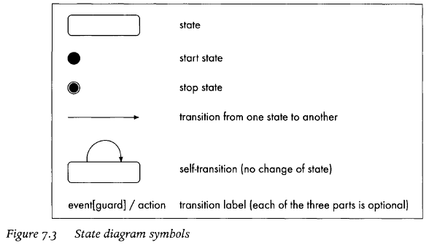
State Diagram Symbol

Slide 24
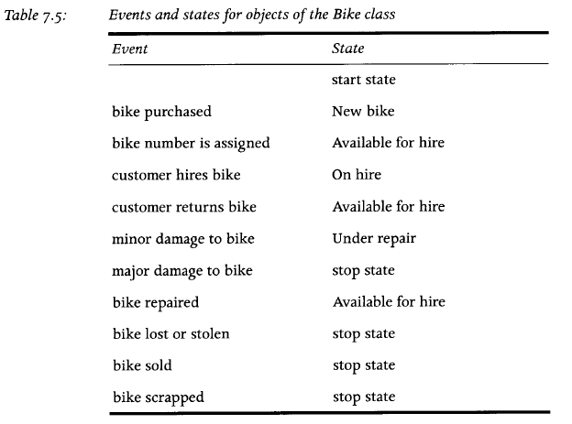
Table Event Wheel

Slide 25

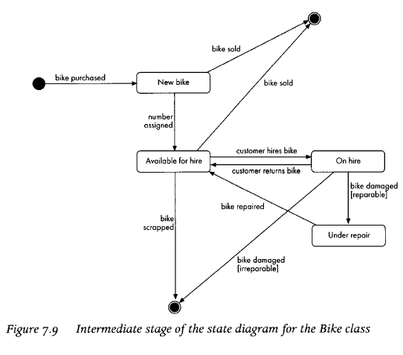
State Diagram Wheel

Slide 26
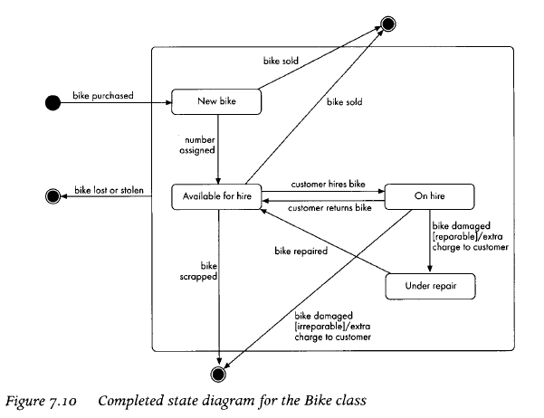
Complete State Diagram

Slide 27
References
Simple Program Design : A Step by step approach., Lesley Anne Robertson, Fifth Edition, Course Technology. ISBN: 978-1-4239-0132-7.
Britton, C.. (2005). A student Guide to Object Oriented Development. 01. Butterworth-Heinemann. Amsterdam. ISBN: 978-0-7506-6123-2.
Class Diagram, http://ww.ibm.com/developerworks/rational/library/content/RationalEdge/sep04/bell
Aggregation, http://java.about.com/od/a/g/aggregation.htm
UML dan class diagram
Class Diagram, http://www.agilemodeling.com/artifacts/classDiagram.htm
OOA modelling using the UML, http://highered.mcgraw-hill.com/sites/dl/free/0073052337/315745/chap10.ppt

Slide 28
Q & A

